Slide 1
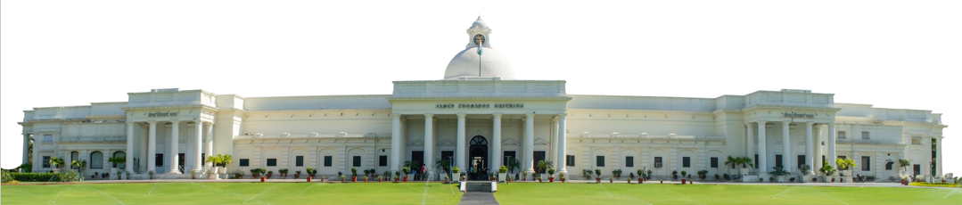
Gradient Descent
Summer Internship- 2026
Name: Udita
Supervisor: Prof. Millie Pant
Mentor: Ms. Riya Applied Mathematics & Scientific Computing
Indian Institute of Technology Roorkee

Slide 2

Table of Content
Introduction to Gradient Descent
Batch Gradient Descent
Stochastic Gradient Descent
Application of Gradient Descent
Reference
Mini-Batch Gradient Descent

Slide 3

Introduction to Gradient Descent
Gradient Descent is an optimization algorithm used in machine learning to minimize the loss (cost) function by adjusting the model's parameters (weights and biases).
How Gradient Descent Works
The algorithm follows these steps:
Initialize parameters (weights) with random values.
Calculate the loss using the current parameters.
Compute the gradient, which indicates the direction of the steepest increase in the loss.
Update the parameters by moving them in the opposite direction of the gradient (toward lower loss).
Repeat until the loss stops decreasing significantly or a maximum number of iterations is reached.
Formula
Where:
θ = model parameter(weight and biases)
α = Learning rate
J(θ) = cost(loss) function
∂J(θ)/∂θ= Gradient of the cost function with respect to the weight
In mathematics: Gradient = slope of a line or curve.

Slide 4
Example
Suppose a model has:
Current weight w = 5
Gradient =2
Learning rate =0.1
w=5−(0.1×2)=4.8
The weight moves from 5 to 4.8, reducing the loss.
Batch Gradient Descent (BGD)
Stochastic Gradient Descent (SGD)
Gradient Descent
Mini-Batch Gradient Descent (MBGD)

Slide 5

Types of Gradient Descent
Batch Gradient Descent (BGD) : Batch Gradient Descent (BGD) is an optimization algorithm in machine learning that uses the entire training dataset to calculate the gradient (slope of the loss function) and updates the model parameters (weights and biases) once after processing all training examples.
Working of Batch Gradient Descent
Initialize the model parameters randomly.
Use the entire training dataset to calculate the average of total loss.
Compute the gradient for all training examples.
Update the weights once.
Repeat the process until the loss is minimized or the model converges.
Formula
Where:
w = Model parameter (weight)
α (alpha) = Learning rate
J(w) = Loss (cost) function
∂J(w)/∂w = Gradient computed using the entire dataset
Training Dataset
(All Training Samples)
│
▼
Calculate Total Loss
│
▼
Compute Gradient
(Using Entire Dataset)
│
▼
Update Weights
│
▼
Repeat Until Minimum Loss

Slide 6
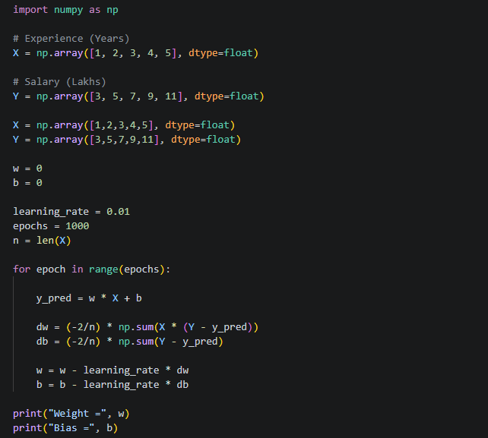

Slide 7

Stochastic Gradient Descent (SGD) : Stochastic Gradient Descent (SGD) is an optimization algorithm in machine learning that updates the model parameters (weights and biases) after processing each individual training example, instead of using the entire dataset.
The word "stochastic" means random, because the training samples are usually
selected in random order.
Working of Stochastic Gradient Descent
Initialize the model parameters randomly.
Select one training example.
Calculate the prediction and loss for that example.
Compute the gradient.
Update the weights immediately.
Repeat the process for every training example until the model converges.
Formula
Where:
w = Model parameter (weight)
α (alpha) = Learning rate
Jᵢ(w) = Loss for the i-th training example
∂Jᵢ(w)/∂w = Gradient calculated from a single training example
Training Dataset ┌───────────────────────┐ │ Sample 1 │ │ Sample 2 │ │ Sample 3 │ │ ... │ │ Sample N │ └───────────────────────┘ │ ▼ Pick One Training Sample │ ▼ Compute Gradient │ ▼ Update Weights │ ▼ Pick Next Training Sample │ ▼ Repeat Until All Samples Are Used

Slide 8
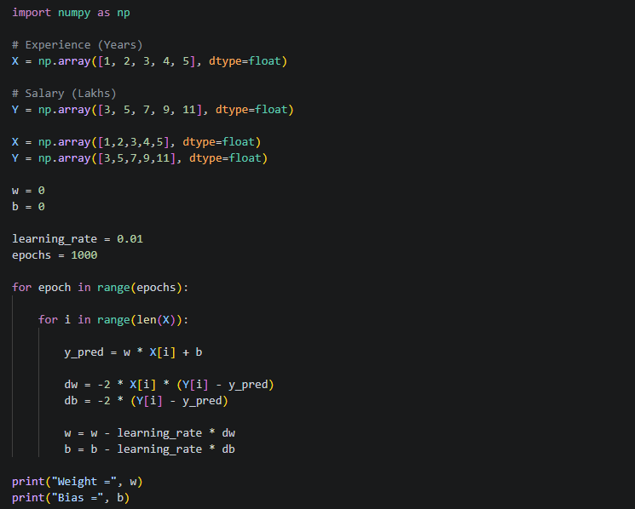

Slide 9

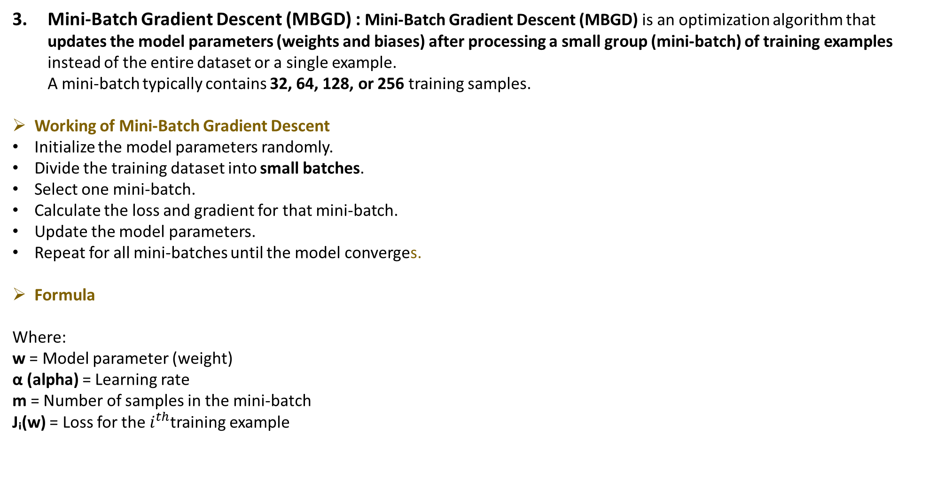
Mini-Batch Gradient Descent (MBGD) : Mini-Batch Gradient Descent (MBGD) is an optimization algorithm that updates the model parameters (weights and biases) after processing a small group (mini-batch) of training examples instead of the entire dataset or a single example. A mini-batch typically contains 32, 64, 128, or 256 training samples.
Working of Mini-Batch Gradient Descent
Initialize the model parameters randomly.
Divide the training dataset into small batches.
Select one mini-batch.
Calculate the loss and gradient for that mini-batch.
Update the model parameters.
Repeat for all mini-batches until the model converges.
Formula
Where:
w = Model parameter (weight)
α (alpha) = Learning rate
m = Number of samples in the mini-batch
Jᵢ(w) = Loss for the $i^{th}$training example

Slide 10
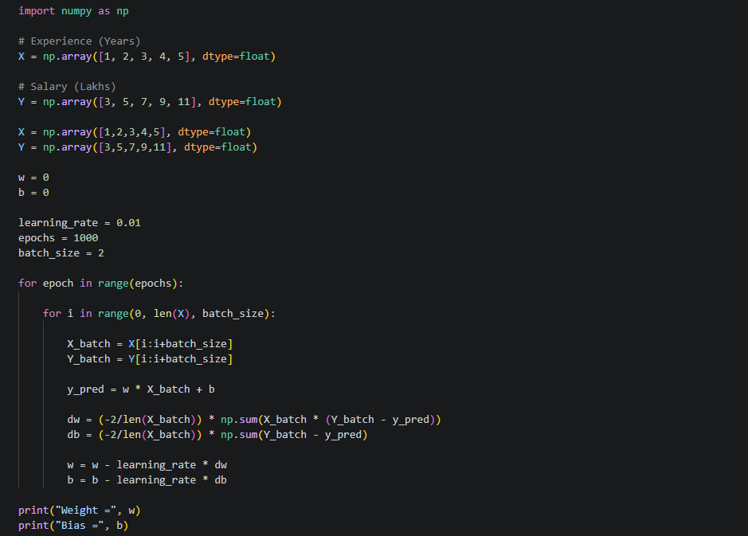

Slide 11
Difference Between the Three Types of Gradient Descent
Feature | Batch Gradient Descent (BGD) | Stochastic Gradient Descent (SGD) | Mini-Batch Gradient Descent (MBGD)
Definition | Uses the entire dataset to calculate the gradient before updating the weights. | Uses one training sample at a time to calculate the gradient and update the weights. | Uses a small batch of training samples to calculate the gradient and update the weights.
Data Used per Update | All training samples | One training sample | A small batch (e.g., 32, 64, 128 samples)
Weight Updates | Once after processing the entire dataset | After every training sample | After every mini-batch
Speed | Slow | Fast | Moderate to Fast
Memory Usage | High | Low | Moderate
Accuracy of Gradient | High (exact gradient) | Noisy (approximate gradient) | More stable than SGD, less exact than BGD
Convergence | Smooth and stable | Fast but may fluctuate | Fast and stable
Best For | Small datasets | Very large or streaming datasets | Large datasets and deep learning
Example | 1,000 student records processed together, then update once | Update after each of the 1,000 student records | Process 100 records at a time, then update

Slide 12
Application of Gradient Descent
Application | Example | How Gradient Descent Helps
Linear Regression | House price prediction | Learns the best-fit line by reducing prediction error.
Logistic Regression | Spam email detection | Improves classification accuracy.
Neural Networks | Digit recognition | Updates weights and biases to recognize digits correctly.
Deep Learning | Face unlock | Learns facial features for accurate recognition.
Computer Vision | Traffic sign detection | Improves object and image recognition.
Recommendation Systems | Netflix | Learns user preferences for better recommendations.
Fraud Detection | Credit card fraud | Detects suspicious transactions more accurately.
Medical Diagnosis | Cancer detection | Improves disease prediction accuracy.
Speech Recognition | Siri/Alexa | Converts speech to text more accurately.
Self-Driving Cars | Pedestrian detection | Learns to identify road objects and people safely.

Slide 13
Reference
GeeksforGeeks | https://www.geeksforgeeks.org/machine-learning/
Wikipedia | https://en.wikipedia.org/wiki/Machine_learning
Kaggle | https://www.kaggle.com
-learn documentation | https://scikit-learn.org
Scikit

